Slide 1
AN ARDUINO BASED VEHICLE TRACKING SYSTEM USING GPS AND GSM MODULES (TRACKIT)
BRIAN KIBET RONOH – P15/81773/2017
SUPERVISED BY DR. KAHONGE

Slide 2
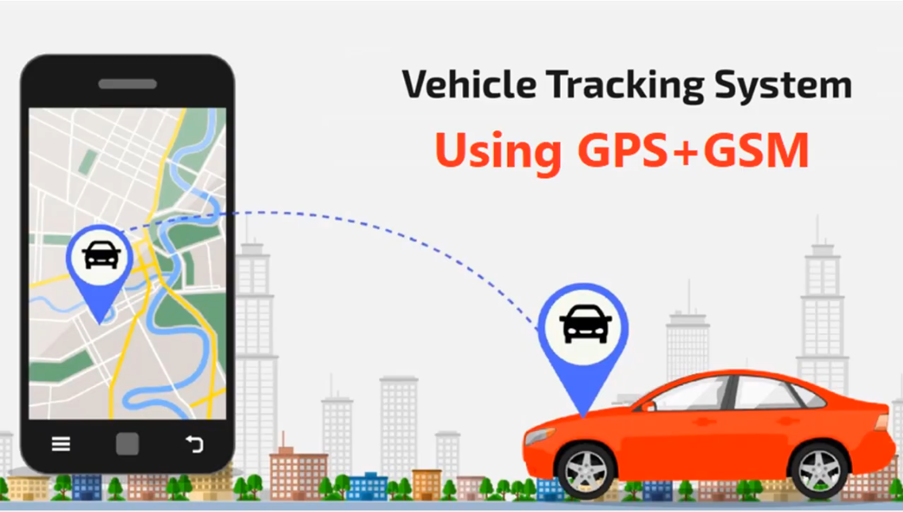

Slide 3
Problem DEFINITION.
The number of vehicles are drastically increasing, and security flaws is becoming a major issue. The global issue related to a constantly increasing crime rate needs to be urgently addressed by both developed and developing countries. In 2018, private car theft rate for Kenya was 0.9 cases per 100,000 population (1370 cases). Though Kenya private car theft rate fluctuated substantially in recent years, it tended to decrease through 2004 - 2018 period ending at 0.9 cases per 100,000 population in 2018 (Kenya Private car theft rate, 2003-2020 - knoema.com, 2021). The figure doesn’t account for unreported stolen vehicles – many owners don’t report stolen cars as they don’t believe they’ll get them back. If not recovered soon, stolen vehicles are generally sold, revamped or even burned if the resale price is considered to be too low. Once a vehicle is stolen, it becomes hard to locate it and track it, which considerably decreases the chances of recovering it. Hence, there is need for fleet-based companies, individuals and companies to use a tracking system to track and trace their cars in case of theft or monitor misuse by employees. In this work, I propose the design and implementation of a car tracking anti-theft system that will protect and secure vehicles.

Slide 4
Introduction.
Vehicle tracking systems are devices fitted into vehicles that allow real time information to be sent back to a central server. They have many beneficial uses. A vehicle tracking system's most obvious use is to constantly know the vehicle’s position.
TrackIt is an Arduino based solution with an Android user interface which allows corporate/fleet owners/individuals to track, trace and monitor their vehicles in real time using GSM, GPS and GPRS technology.

Slide 5
SCOPE AND POSSIBLE APPLICATIONS
Systematic transportation management – system to alert when automobile is approaching.
Car renting businesses – Monitor the vehicle in agreement terms.
Logistics, cargo distribution and transportation – fleet management.
Public service – to avoid misuse of government/company vehicles.
Asset tracking – expensive assets can be tracked and traced in case of theft.
Private yatches and fishing boats – to locate in case of an emergency

Slide 6
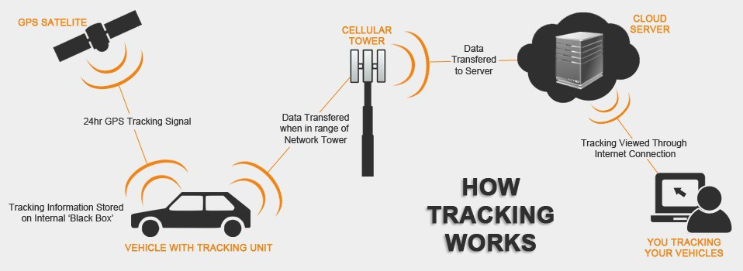
HOW IT WORKS.

Slide 7
FeATURES OF THE SYSTEM.
The Android interface plots the current location on a map.
The Android interface shows a location history by plotting all the locations travelled on the day queried by the user.
The system has a report feature where users can share a drafted report message to social media accounts and optionally call 911 in case of theft.
The IoT device sends an SMS containing location details to the user in case of absence of internet connectivity.

Slide 8
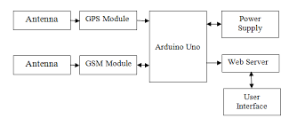
SYSTEM OVERVIEW – block diagram

Slide 9
HARDWARE COMPONENTS.
Arduino Uno R3
SIM 808
GPS antenna
GSM antenna
Male-Female Dupont connecting wires.
Power supply – 9V-2A power adapter

Slide 10
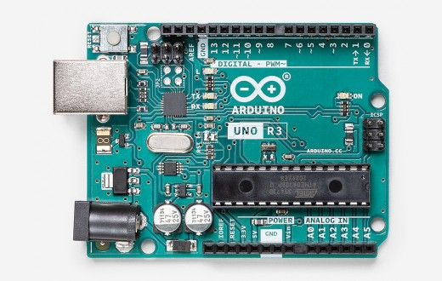
Arduino Uno r3
Arduino Uno is a microcontroller board based on the ATmega328P.
It has 14 digital input/output pins (of which 6 can be used as PWM outputs), 6 analog inputs, a 16 MHz ceramic resonator
It contains everything needed to support the microcontroller; it is simply connected to a computer with a USB cable or power it with an AC-to-DC adapter

Slide 11
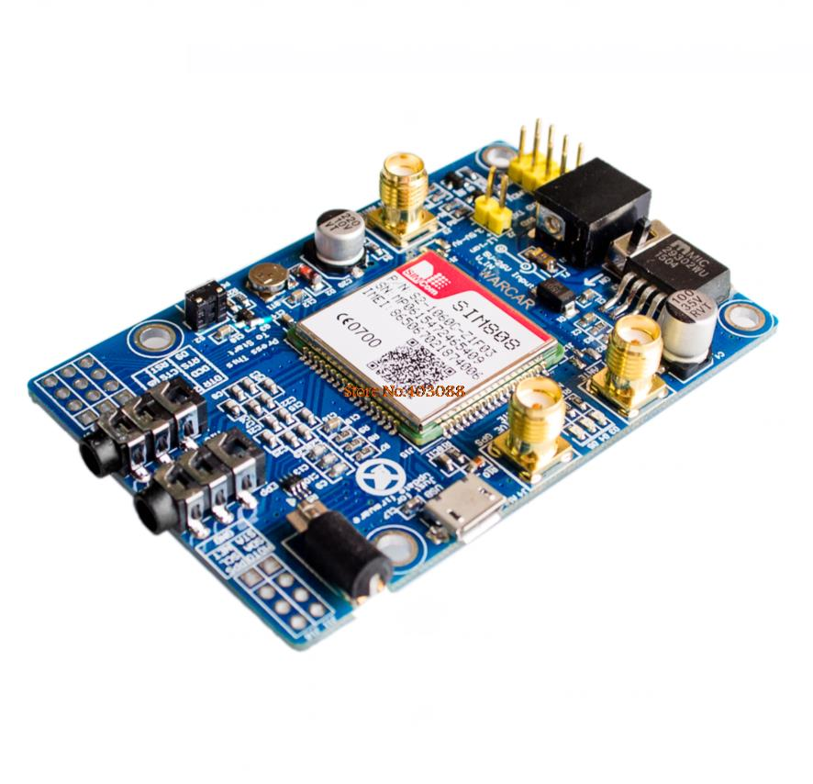
SIM 808
SIM808 module is a complete Quad-Band GSM / GPRS module which combines GPS technology for satellite navigation.
It has a SIM application toolkit where SIM card can be inserted.
It supports instructions of AT commands
It is used to configure and communicate with the GPS receiver, in order to call for data about satellite status and geographical positioning and to transfer them to the microcontroller. This is the approach followed in the design of this project.

Slide 12
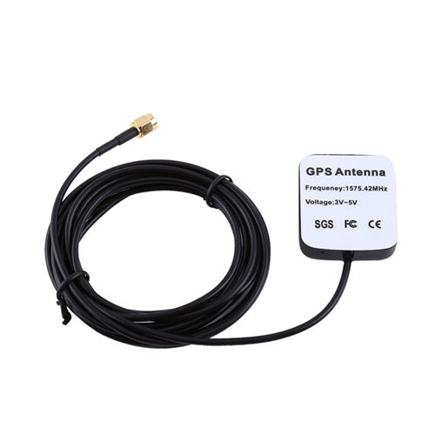
GPS ACTIVE ANTENNA
GPS signals are extremely weak and present unique demands on the antenna, so the choice of antenna plays an important role in GPS performance.
A GPS unit needs to have a clear, unobstructed sky view, to best receive the microwave signals that allow it to communicate with satellites.
This GPS antenna receives the GPS signal, converts it to a lower frequency which is then sent down the cable.

Slide 13
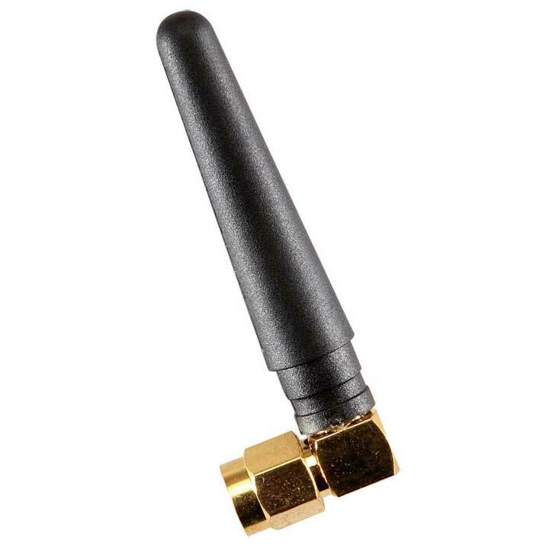
GSM ANTENNA
GSM communications are dependent on antennas.
The antenna is what allows communications signals to be sent and received.
The antenna that I have used in this project provides operation at both GSM Quad Band Frequencies with +2dBi gain [10].
This antenna operates in Quad Band 890/960, 1710/1880 MHz Frequencies and it’s omni-directional.
Notes:
Omnidirectional antennas receive signals equally from all directions.

Slide 14
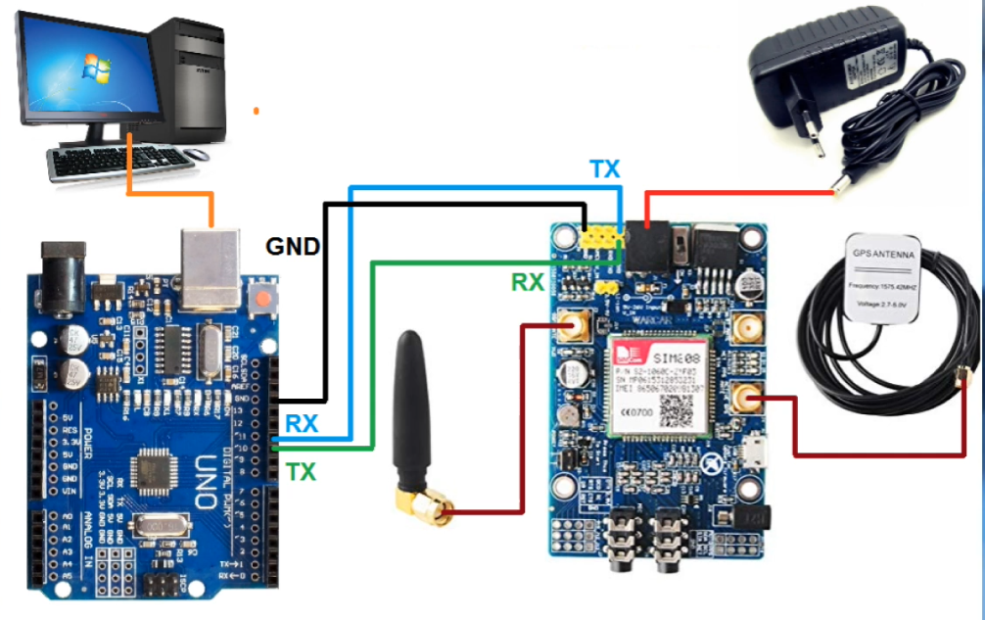
CIRCUIT DIAGRAM.

Slide 15
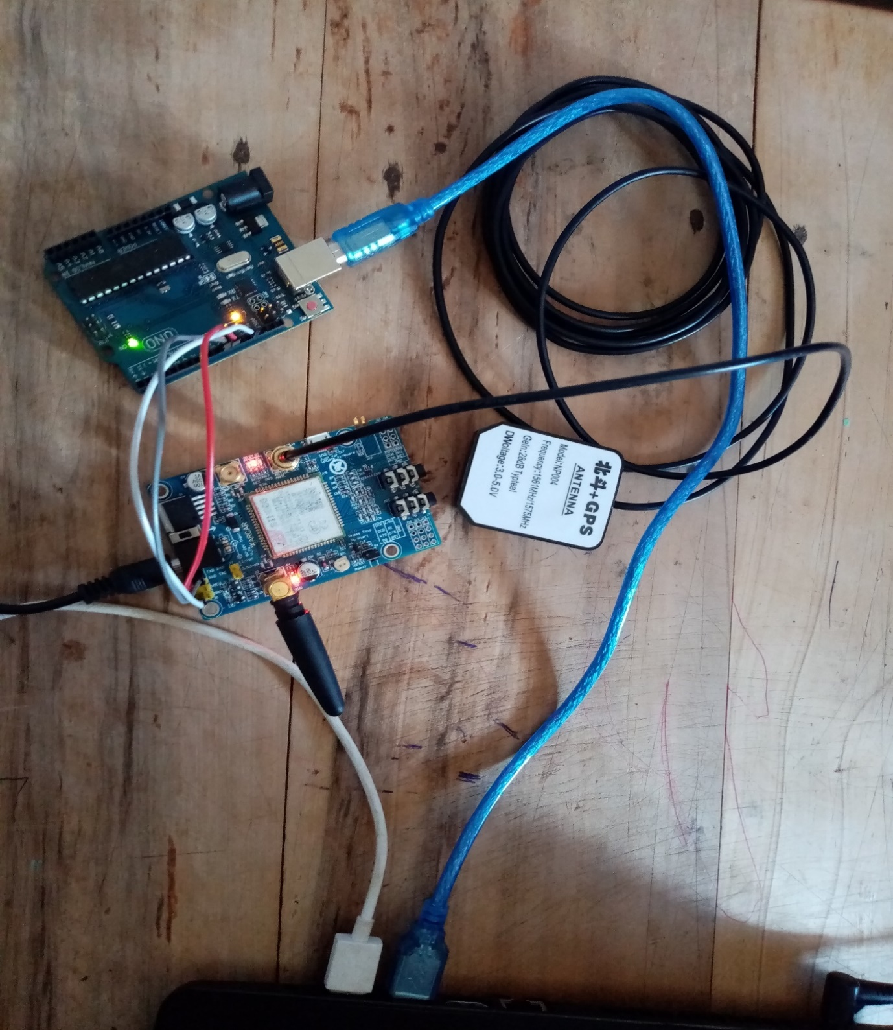
IMPLEMENTATION/ CONNECTION OF HARDWARE

Slide 16
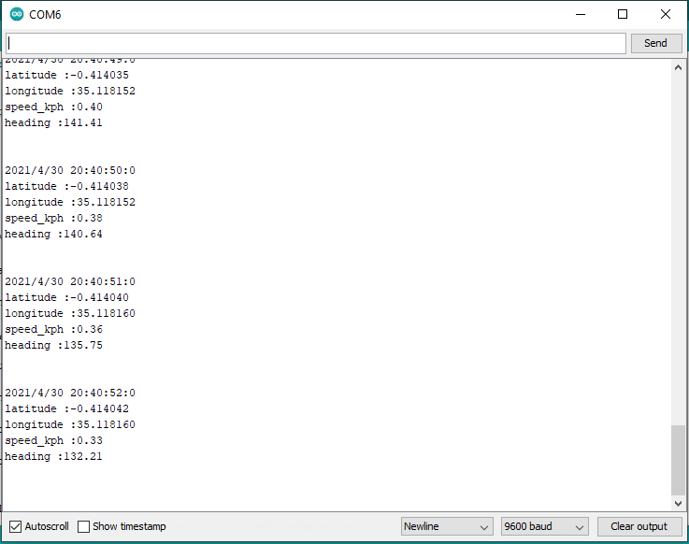
HARDWARE IMPLEMENTATION RESULT VIA SERIAL MONITOR.

Slide 17
HARDWARE IMPLEMENTATION DEMO

Slide 18
WEB SERVER
The hardware device should be able to send location data to a remote database for storage through GPRS technology. Internet Service providers could not provide a service for local hosting of a database. For this reasons, a remote web server was required to host a database.
A MySQL database was used and was hosted in the cloud by Hostinger (000webhost.com) web hosting service company.
REST APIs (PHP scripts) were also stored in the server. In this way, the hardware device could store information on the database while the Android app would authenticate users and fetch location data from the database to display on a map.

Slide 19
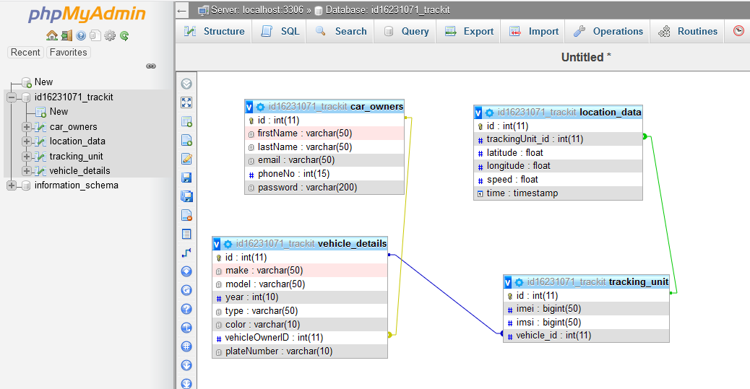
DATABASE SCHEMA.
Notes:
The database was designed to store the user data e.g., vehicle details, personal information, tracking device details and location data.

Slide 20
ANDROID APPLICATION.
The focus here was to design and build the Android application and connect it to the MySQL database and display the location on Google map.
Taking into consideration the tracking information stored in the database and what was expected to be displayed to the user, the application settled on the following main activities:
Login Activity.
Register Activities.
Car Details activity.
Map Activity
Location History Activity
Tracking Device Details
Help Page activity

Slide 21
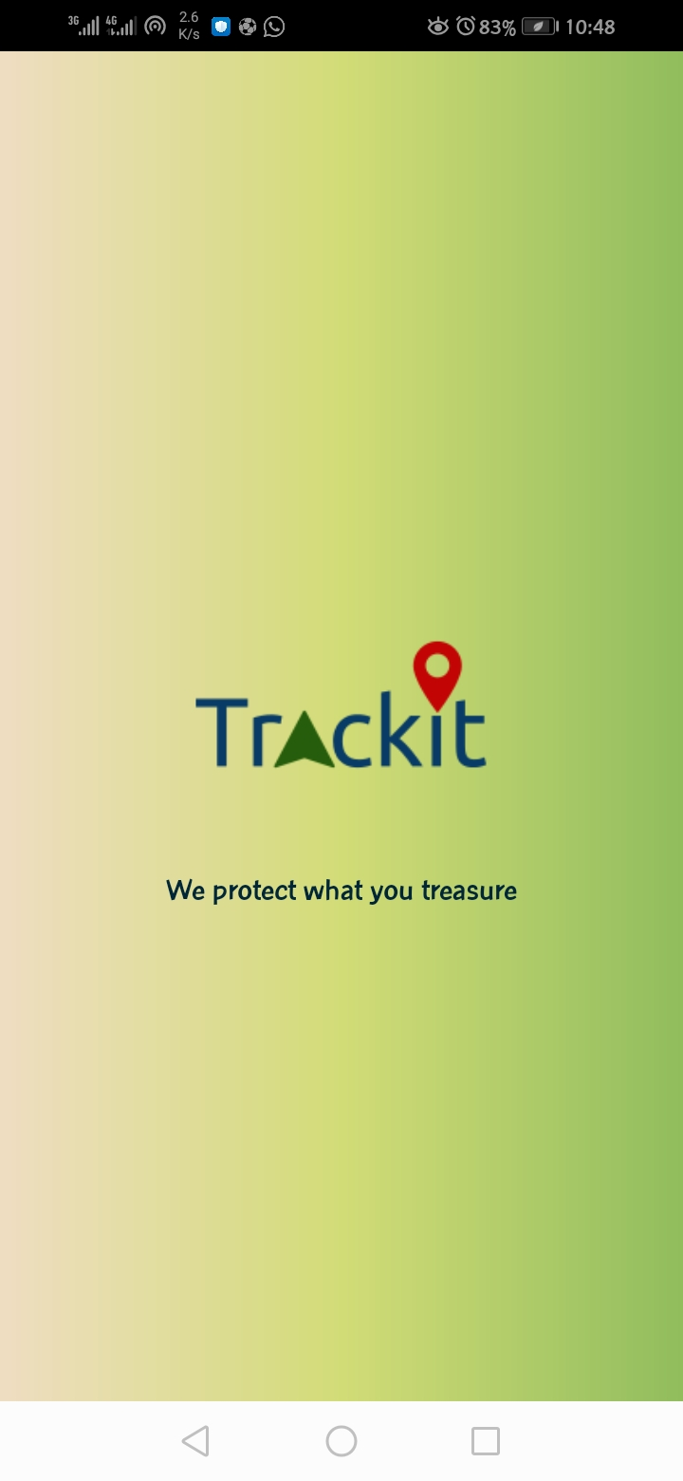
APPLICATION DEMO

Slide 23
CHALLENGES AND LIMITATIONS
For the GPS to work properly, it needs to have a clear view of the sky. That is, it is unlikely to work indoor or may even have problem outside where it has no clear path of transmitting to and receiving signal from satellites. Therefore, due to obstacles like tall buildings or such infrastructure which block view of the sky, often causes multipath error to the receiving signal of the GPS receiver. As a result, location seems to appear to jump from one place to another leading to inaccurate results. Thus, incorrect values of latitude and longitude are sent to the server, for displaying in the Google map on error being initialized.

Slide 24
RECOMMENDATIONS FOR FURTHER WORK
This project has demonstrated that IoT-based tracking is technically feasible for fleet management and vehicle tracking. Future projects can explore the following:
Reduction of the size of the tracking device by using GPS+GSM on the same module.
With the help of high sensitivity vibration sensors, accident detection can be integrated with the system. Upon detection, the system should send the location to the owner, nearest hospitals or the police.
Upon reporting the vehicle stolen, the owner can be able to lock the car remotely and disable the engine to avoid further movement.

